Slide 1

Asset Security

Slide 2
Information Life Cycle
Data that is combined to form meaning
Information has worth to the organization
Information is either created or copied (predominantly copied)
4 Phase life cycle
Acquisition
Use
Archival
Disposal
Notes:
How presentation will benefit audience: Adult learners are more interested in a subject if they know how or why it is important to them.
Presenter’s level of expertise in the subject: Briefly state your credentials in this area, or explain why participants should listen to you.

Slide 3
Information Life Cycle
Acquisition
Copying or created
Use
Presents the most challenge in protection
Archival
Important to decide on the needs for backup and how they are protected
Disposal
System data and business process data are attached
Information is indexed
Access control on data access implemented
Roll-back capability to be provided
Controls to ensure Internal consistencies
Need to decide on the retention period
Two key aspects
Data is indeed destroyed
It is destroyed correctly
How and where is stored is critical for destruction
Data Backup | Data Archive
Copy of current data set that is used as backup if loss of the original data set It becomes less useful over time | Copy of data set that is no longer in use, but retained for use later Data from original location is destroyed

Slide 4
Understanding Sensitive Data
The First step in Asset security is to classify and label the asset
What is Sensitive Data?
Any information that is not public or unclassified
Any type of data that an organization has value upon and shall protect or comply with law and regulations
Personally Identifiable Information
Any information that can identify an individual
Race, name, SSN, date, place of birth, biometric, medical, financial, employment information
Protected Health Information
An health related information that can be related to an individual
Oral or written information created or received by health care related entities
Relates to past, present or future medical information of an individual
Proprietary Data
Any data that helps an organization to maintain a competitive edge
If lost, it can seriously affect the primary mission of an organization

Slide 5
Information Classification
Refers to the practice of differentiating between different types of information assets and providing some guidance as to how they must be protected
It is an ongoing process and not one-time effort
Important metadata item that should be attached to all information is ~ classification level
The classification level should be always attached throughout the lifecycle of the information

Slide 6
Information Classification
Classification
Identifies the value of the data to the organization
It also identifies how data owners can determine the proper classification, and personnel should protect data based on classification
Classification authority is the one who applies the original classification to the sensitive data
Categorization
Process of determining the impact due to the loss of CIA of information to an organization
Classification and categorization help to set baselines for information systems

Slide 7
Information Classification
Information is classified by Sensitivity, criticality or both
Sensitivity:
Loss to an organization if the information is released to unauthorized entities
Organizations can loose trust and spend expensive response efforts in remediation
Criticality
Indicator of how the loss will impact the fundamental business process of the organization
It is that which is required for the organization to continue business

Slide 8
Information Classification
Primary Purpose:
Helps indicate the level of confidentiality, integrity and availability protection that is needed for each type of data
Helps ensure data is protected in a most cost effective manner
Each classification should have separate handling requirements and procedures

Slide 9
Classification Guidelines
When classifying data, take into consideration
Who has access to data
How the data is secured
How long the data is retained
What methods used to dispose the data
Whether the data needs to be encrypted
What use of the data is appropriate
Keep the classification small
Classification should not be restrictive and detail oriented (either)
Each classification should be unique and separate from others; no overlap effects
Should outline how information is controlled and handled through its life cycle

Slide 10
Classification Procedure
Define Classification Levels
Criteria of classification levels
Data owners who will be responsible for Classification
Data custodians who will be responsible for maintaining data
Security controls for each classification level
Exception documentation to previous classification issues
Methods to transfer data ownership
Procedure to periodically review the classification and ownership
Declassification procedures
Classification awareness to all employees

Slide 11
Data Policy
Defines strategic long term goals for data management across all aspects of project or enterprise
High level principles that establish a guiding framework for data management
It should be flexible and dynamic
Should be readily adaptable for unforeseen circumstances, changing projects, potentially opportunistic partnerships while still maintaining its guiding strategic focus

Slide 12
Data Policy Definition considerations
Cost
Cost of providing access to data vs cost of providing the data
Ownership & Custodianship
Who owns the data and who maintains the data
Privacy
What data is private, what data is made public
Liability
How protected the organization is from legal recourse
Sensitivity
What type of data is in question; what is the impact, type and level of threat, vulnerability for the data
Existing Law and Policy Requirements
May have impact on enterprise data policy
Policy & Process
Consideration should be given to legal request for data and policies that may need to be put in places

Slide 13
Roles and Responsibilities
Objectives of defining roles and responsibilities
Clearly define roles associated with functions
Establish data ownership through out the life cycle of the data
Instill data accountability
Ensure adequate, agreed-upon data quality and meta data metrics are maintained on a continuous basis

Slide 14
Data Owner
Key aspect of good data management involves identification of information owner
Individual or group that created, acquired or purchased information that supports the mission of the organization
Has legal rights over the data
Ownership implies the right to exploit the data as well as the right to destroy it

Slide 15
Data Owner - Responsibilities
Determine the impact the information has on the organization
Understand the replacement cost of the information
Establish the rules of appropriate use and protection of information
Decide who has access to the information and what privilege
Know when the information is inaccurate or no longer needed and should be destroyed
Provide input to system owners regarding security requirements and controls for the information system that hold the data
Assist in identification and assessment of common security controls
Delegates day-to-day maintenance to the data custodian

Slide 16
Data Owner - Responsibilities
Data Owner shall establish and document the following
The ownership, IP rights and copyrights for their data
The statutory and non-statutory requirements relevant to their business to ensure the data is compliant
The policies for data security, disclosure, pricing and dissemination
Contracts with users and customers on conditions of use, before the data is released

Slide 17
Data Custodian
Data custodian ensures important data sets are developed, maintained and are accessible within their defined specifications.
Best handled by entity that is most familiar with a datasets content and its management criteria
Responsibilities include
Adherence to data owner guidelines
Ensure access to appropriate users and maintaining appropriate level of security
Dataset maintenance, including data storage and archival
Dataset documentation, including changes to documentation
Quality Assurance and validation to assure ongoing data integrity

Slide 18
System Owner
A person who owns the system processing sensitive information
One system may have multiple information owners
Responsibilities
Develop a system security plan in coordination with Information owners
Maintain the plan and ensure it operates according to the agreed security requirements
Ensure system users and support personal get security training
Update the plan whenever major change happens
Assist in identification, implementation and assessment of common security controls

Slide 19
Other Roles
Security Administrator:
Responsible for maintaining specific security devices
Creating new user accounts, implementing new security software, testing security patches
Has the main focus of keeping the network secure; network administrator has main focus on keep the IT running
Supervisor
Ultimately responsible for all actions of the users under them
Responsible for making sure access changes are done for user accounts as and when there is change in user role

Slide 20
Other Roles
Data Analyst:
Ensures data is stored in a way that makes more sense to the company
Responsible for architecting a new system that will hold company information or advice in purchase of a product
Works with data owners to help ensure that the structures setup support business objectives
Change Control Analyst
Responsible for approving or rejecting requests to make changes to the IT environment
Makes sure certain changes do not introduce new vulnerabilities, it has been tested, and it is properly rolled out

Slide 21
Other roles
Data processor is an individual or organization that processes personal data solely on behalf of data controller
Data Controller is an entity that controls processing of personal data
Users are those who access data to accomplish work tasks. They should have access to only the data they need to perform their work

Slide 22
Data Quality
Data Quality determines the fitness for use or potential use of data
2 factors considered for setting data quality expectations are
Frequency of Incorrect data fields or errors
Significance of error within a data field
Errors are more likely be determined when expectations are clearly documented
2 Keys to improve data quality are
Prevention
Correction
Documentation is key to good data quality
Two types of data documentation
Records what data checks have been done and what changes have been made and by whom
Metadata that records information at the dataset level

Slide 23
Data Quality
Data Quality is assessed by applying Verification and validation procedures
Helps ensure data is valid and reliable
Verification
Process of checking the completeness, correctness and compliance of a dataset to ensure the data is what it claims to be
Checks that the digitized data matches the source data
Validation
Evaluates verified data to determine if data quality goals have been achieved and the reasons for deviation
It follows data verification
Checks that the data makes sense
Can be done by personnel who are less familiar with the data
Requires in-depth knowledge about the data and should be conducted by experienced personnel

Slide 24
Data Quality
Quality Control
Assessment of data quality based on Internal standards, processes, and procedures established to control and monitor quality
Quality control procedures monitor and evaluate the resulting products
Quality Assurance
Assessment of quality based on standards external to the process and involves reviewing of activities and QC processes to ensure final product meets predetermined quality standard
Maintains quality through-out all stages of data development

Slide 25
Quality Control and Assurance
QA/QC are designed to prevent data contamination due to two fundamental types of errors
Errors of omission
Insufficient documentation of legitimate data values
They are harder to detect and correct
Can be revealed by rigorous QC procedures
Errors of commission
Caused by data entry, transcription or malfunctioning equipment
This is common, fairly easy to identify and effectively reduced by QA measures in data acquisition process as well as QC procedures after the data has been acquired

Slide 26
Stage of Data Management Process
Capture/Collect
Digitization
Storage
Analysis
Presentation
Use

Slide 27
Data Documentation
It is critical to ensure datasets are useable well into the future
The first step in data management process is to enter data into a electronic system
Objectives of Data documentation are
Ensure the longevity of the data and their re-use for multiple purposes
Ensures data users understand the context and limitations of datasets
Facilitate discovery of datasets
Facilitate interoperability of datasets and data exchange

Slide 28
Dataset titles and filenames
Titles and filenames should be descriptive
Should reflect the contents of the file and include enough information to uniquely identify the data file
Filename should be provided in the first line of the header rows in the file itself
Names should only contain numbers, letters, dashes and underscore
Lowercase is, less software and platform dependent, and hence is preferable
File name should not be more than 64 characters
Versioning and file creation date will help user know if they are using the correct file

Slide 29
Metadata
Definition: Set of data that gives information about other data
Three types of metadata:
Descriptive metadata:
Describes a resource for discovery and identification
title, keyword, tag, author
Structural metadata:
Facilitates navigation and presentation of electronic information; provides information about internal structure; binds related files
TOC, index, chapters, title page
Administrative metadata:
Provides information to help manage a resource
Filetype, who created, when it was created

Slide 30
Data Standard
Rules by which data are described and recorded
When adopting a standard adopt a minimally complex standard that addresses the largest audience
Benefits of data standard
More efficient data management
Increased data sharing
Higher data quality
Improved data consistency
Increased data integration
Better understanding of the data
Improved documentation of information resoruces

Slide 31
Data Lifecycle Control
Data management includes
Data specification and modeling
Database maintenance and security
Ongoing Audit
Archiving

Slide 32
Data Specification and Modelling
Successful database planning requires thorough user requirements analysis and followed by data modeling
Data modelling is the methodology that identifies the path to meet user requirements
Data modelling should be iterative and interactive
Data model consists of written documentation of the concepts to be stored in the database, their relationships, and diagram showing those concepts and their relationships
Data model is the tool to help the design and program teams understand the nature of information to be stored
Data model helps in communication between data content experts specifying what the databases need to do and database developers who are building the database

Slide 33
Database maintenance
Technology obsolescence is a significant cause for information loss
Major changes to hardware/software should be noticed and data should be migrated to newer platforms
Data should be stored in formats that are independent of specific platform or software
Versioning should be used in multi-user environments
Database management requires day-to-day system administration

Slide 34
Data Audit
Data audit process involves:
Identifying the information needs of the organization and assigning a level of strategic importance
Identifying the resources and services currently provided to meet those needs
Benefits of data audit are:
Awareness of data holdings
Promote capacity planning
Facilitate data sharing and reuse
Monitor data holding and avoid data leaks
Recognition of data management practices
Promote efficient use of resources and improved workflows
Increase ability to manage risks
Enable the development/refinement of data strategy

Slide 35
Data Retention
Data Retention Guidelines
Involve all stake holders in the process of aligning the business and legal requirements for the data retention policies
Establish common objectives for supporting archiving and data retention best practices
Monitor, review and update documented data retention policies and archiving procedures.
Data retention policy should
Outline the classification of records
Retention and destruction schedules
Parties responsible for retention and destruction
Procedures used for destruction
Training
Policy should answer the following questions
What data is stored?
How long is it stored?
Where is it stored?

Slide 36
Data Retention
For retained data to be useful, it should be accessible. Consider following issues for data accessibility
Taxonomy:
Scheme for classifying the data; could be functional, chronological, or combination of categories
Classification:
Sensitivity determines the controls we put in place during the lifecycle of the data
Normalization:
Data comes in many formats; storing the data in original format may render it inaccessible later in time; its prudent to tag data sets to ensure search ability and accessibility
Indexing:
Indexing archived data for future searches;

Slide 37
e-Discovery
Process of producing for a court or external attorney all ESI (Electronically Stored Information) pertinent to a legal proceeding
8 Step Electronic Discovery Reference Model (EDRM)
Identification
Preservation
Collection
Process
Review
Analyze
Production
Presentation

Slide 38
Managing Sensitive Data
Marking (Labeling)
Ensures users can easily identify the classification of the data
It also includes digital marks or labels
Asset handling different classification of data, should be marked with the top most classification it handles
When media is found without label, it should be labeled with the highest level of sensitivity until appropriate analysis is done.
Handling
Refers to secure transport of media through its lifetime
Policies and procedures should be in place to ensure people understand how to handle sensitive data
Encryption is the obvious choice for protecting sensitive data at rest.

Slide 39
Data at rest
Three broad categories of encrypting tools for the data at rest
Self-encrypting USB Drives:
USB drives embed encryption algorithms within the Hard-drive
Everything in the drive is automatically encrypted
Files moving out of the drive are in decrypted state
Media Encryption Software:
Software used to encrypted the media
Flexibility of software allows encrypting various storage media types
Has the same problem as above, files outside the drive remain un-encrypted
File Encryption Software
Allows greater flexibility in encrypting specific files
Since encryption is applied at file level, it stays encrypted irrespective of the media it is stored.

Slide 40
Data in Transit
Mechanism to prevent content of the message is protected even if the message itself is intercepted.
Link encryption
Performed by service providers
Encrypts all data, including routing data, along a communications path
Communications nodes need to decrypt data in order to continue routing
It provides traffic confidentiality better than end-to-end encryption
Prevents inference attack
End to End Encryption
Generally performed by end user
Encrypted at the start of the communication channel
Routing information remains visible

Slide 41
Data in Use
Data residing in primary storage devices ~ Volatile memory (registers, memory cache, RAM)
Data in use generally cannot be protected by encryption
Attacks
Side Channel Attack: exploits information flow that is the electronic byproduct of a process (like encryption)
Data in use can be protected by
Ensuring software is tested against these attacks
Secure development process

Slide 42
Data Remanence
Data remanence is the data that remains in the hard drive as residual magnetic flux or after erasing
Data remanence in HDD is caused by the failure of the method used to clean the HDD
Commonly used method to address data remanence are
Erasing
Simple deletion process; does not remove the files, but only removes the catalog reference
Anyone can typically retrieve the data using widely available tools

Slide 43
Data Remanence
Clearing (overwriting/wiping/shredding)
Process of preparing media for reuse with assurance that cleared data cannot be retrieved using traditional recovery means
Unclassified data is written over all addressable locations on the media
Data recovery requires special laboratory techniques
Some media types don’t respond well to clearing
Purging
More intense form of clearing – repeats the clearing process multiple times
Provides assurance that data cannot be recovered using any known means
It can be combined with other means like degaussing to completely remove data

Slide 44
Data Remanence
Declassification
Any process that purges media or system in order for reuse in unclassified environment
Sanitization
Combination of process that ensures data is removed from the system
It ensures data cannot be recovered by any means
Includes ensuring non-volatile memory is erased, external drives removed and sanitized
Degaussing
Generates heavy magnetic fields which realign the magnetic fields in magnetic media, only effective on magnetic media (does not affect, CD/DVD/SSD)
AC erasure – medium is degaussed by applying alternating field that is reduced in amplitude over time
DC erasure – medium is saturated by applying a unidirectional field

Slide 45
Asset Management
Asset management is the foundation for Information Security
Inventory management deals with what assets are there, where they reside and who owns them
Configuration management adds a relationship dynamic relating the other items in the inventory
IT Asset Management (ITAM) introduces financial aspects of the asset – cost, value and contractual status
ITAM also refers to full lifecycle management of the asset
ITAM is designed to manage the physical, contractual and financial aspects of the asset

Slide 46
Asset Management Enablers
A single, centralized, relational repository
Organizational alignment and defined process
Scalable technologies and infrastructure

Slide 47
Equipment Lifecycle
All equipment's have a useful life; they get depreciated over time or when they are no longer capable of performing its tasks
Common Lifecycle tasks
Defining Requirements
Ensure relevant security requirements are included
Ensure appropriate costs have been allocated for security
Ensure new equipment requirements fits into the organizational security architecture
Acquiring and Implementing
Validate security features are included as specified
Ensure additional security configurations are applied
Ensure security certification or accreditation process is followed
Ensure equipment is inventoried

Slide 48
Equipment Lifecycle
Operations and Maintenance
Ensure security features remain operational
Ensure appropriate support is available for security related concerns
Validate and verify inventories
Ensure changes to configuration of system are reviewed
Review equipment for vulnerability
Disposal and Decommission
Ensure secure erasure/ destruction or recycle
Ensure inventories are accurately updated to reflect the status of decommissioned equipment
Guiding principle for media erasure is to ensure that the enemies cost of recovering the data should be higher than the value of the data

Slide 49
Media Destruction
Specific destruction techniques include
Physically breaking the media apart
Chemically altering the media into non readable state
Phase transition
For magnetic media, raising its temperature above the Curie temperature
Crypto-erasure can be used in SSDs to sanitize the data

Slide 50
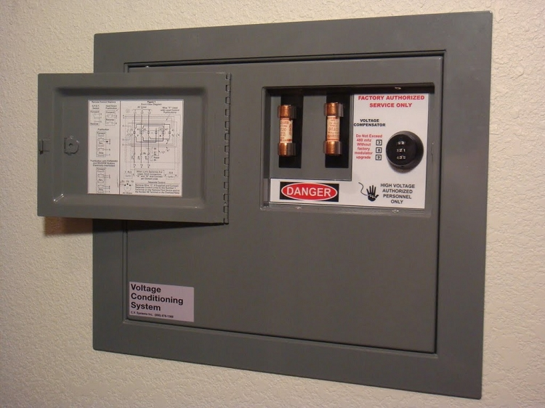
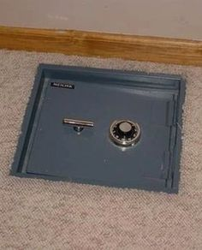
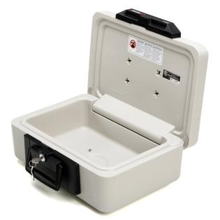
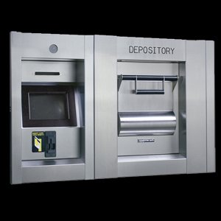
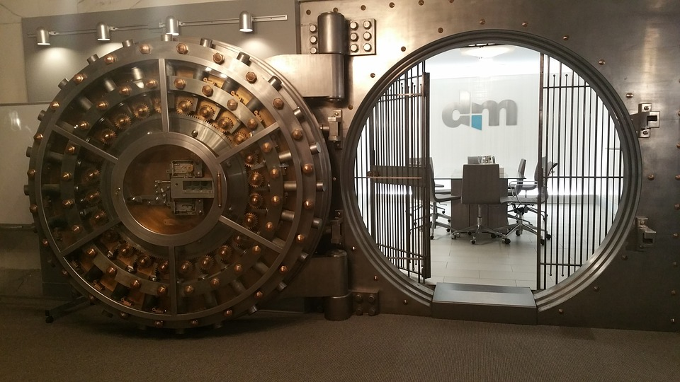
Safes
Wall safe | Embedded into wall and easily hidden
Floor safe | Embedded into floor and easily hidden
Chests | Stand-alone safes
Depositories | Safes with slots that all valuables to be easily slipped in
Vaults | Large enough to provide walk-in access

Slide 51
Data Leakage Prevention
Comprises actions that organizations take to prevent unauthorized external parties from gaining access to sensitive data
DLP is concerned with external parties
DLP should be integrated as part of Risk Management Approach
DLP technology determination aspects
Sensitive data awareness
Policy engine
Interoperability
Accuracy (most critical)

Slide 52
DLP Approach
Data Inventory
Identify the data
Data Flows
Plot the data flow over the lifecycle
Data Protection Strategy
Perform Risk Assessment
Implementation, Testing and Tuning
Test for false positive, false negative
Determine the DLP Solution
Misuse cases prioritization and testing
Classify the data

Slide 53
Data Protection Strategy Considerations
Backup and recovery
Data life cycle
Physical security
Security culture
Privacy
Organizational change

Slide 54
Network DLP
Applies DLP to data in motion
Normally implemented as dedicated appliances at perimeter
Drawback:
It will not protect data on devices that are not on the organization network
Does not have capability to decrypt encrypted tunnels
High cost forces organizations to deploy only at network choke points instead of throughout the network

Slide 55
Endpoint DLP
Applies DLP to data in use and data in rest
An agent is installed on end-systems
Allows more degree of protection than NDLP
Drawback:
Complexity
Agent management
Cost could be much higher than the NDLP
Unaware to data-in-motion protection violations

Slide 56
Hybrid DLP
Deploy both EDLP and NDLP
Costliest and most complex approach
Offers the best coverage and protection

Slide 57
Mobile Device Protection
Mechanisms to protect mobile devices are
Inventory all mobile devices ~ identification
Harden the mobile OS
Password protect the BIOS
Register the device with vendor and get notified if the device is submitted for repair
Do not check-in as luggage in airport
Do not leave the device unattended
Engrave identification mark
Use slot lock
Backup data at regular intervals
Encrypt
Enable remote wiping

Slide 58
Baselining / Scoping / Tailoring
Baseline provides a starting point and ensure a minimum security standard
Scoping refers to reviewing baseline security controls and choosing only those controls that apply to the IT system to be protected
Tailoring refers to modifying the list of security controls within a baseline so that they align with the business mission
Supplementation involves adding assessment procedures to adequately meet the risk management needs of the organization

Slide 59

Karthikeyan Dhayalan
MD & Chief Security Partner
www.cyintegriti.com

